Slide 1
High-Dimensional Bandit
Kohei Watanabe (Intern), Bin Yang (Mentor)
Intelligence domain
RIT Department

Slide 2


Self-Introduction
Kohei Watanabe
2nd year Master Student
Internship Period: 6/22 ~ 9/8 (3 or 4 days a week)
My Lab: Harada-Ushiku Lab (MIL) @Tokyo Univ.
Computer Vision, Machine-Learning…etc
WebDNN[1] is useful when you want to make a demo using deep learning!
[1] https://mil-tokyo.github.io/webdnn/ja/
Notes:
The member of my lab developed WebDNN, that is Fastest DNN execution framework on web browser and made it publically available about 3 months ago.
This supports keras, chainer model converter so if you want to create a demo using deep learning, please try to use this!
If not ,just trying demo of WebDNN using your PC or smartphone is also fun.
Let’s move on to the main topic.

Slide 3
Motivation High-Dimensional Bandit: Automatic Hyperparameter Optimization
It is valuable to conduct next experiment efficiently based on the results of past experiments
especially when experiment cost is high
How many layers, neurons?
Caution
Categorical hyperparameter
is OUT of the target in this research.
e.g.
Activation function(relu, sigmoid, tanh, etc.)
Presence of Dropout
Notes:
Our research topic is High-Dimensional bandit, that is almost the same as automatic hyperparamter optimization.
It is valuable to conduct next experiment efficiently based on the results of past experiments
especially when experiment cost is high like deep leaning.
For example, in deep learning, we have to tune the number of layers or neurons in order to bring out its potential performance.
We would like to tune that automatically using High-Dimensional Bandit algorithms,
There is one thing to note. In this research, we only concentrate on numerical hyperparamter tuning and do not conver categorical hyperparamter like activation function or presence of Dropout

Slide 4
Motivation Hyperparameter Optimization of Recommendation Engine
Also tuning the hyperparameter of recommendation engine
is valuable for improving CTR.
Notes:
Also tuning the hyperparameter of recommendation engine is valuable for improving CTR.
Normal output of machine leaning algorithm such as accuracy is a real value and different from CTR data that consists of the number of clicks and impressions. So it is necessary to transform CTR data to a real value in order to use high-deminsional bandit algorigthms.
I will explain in detail about this at the end of this presentation.

Slide 5
Problem Definition
Find the best parameter of Black Box function from observed and
Parameter
Performance
Input
Output (curve line)
: The point we need
Observations
Observations
Which curve line describes well?
Notes:
Here, I define the problem. The problem is to find the best parameter of Black Box function f(x) from observed parameter X and its performance Y.
For example, we conducted some machine learning experiments three times and got three observations.
Using the observations, we would like to estimate f(x), that is drawn as the green or red or blue curve in the graph that fits the observations the best.
Then we would like to select the highest point of the curve.
This graph is just one dimensional so this seems not so difficult. BUT…

Slide 6
Difficulty of the Problem
Parameter space increases exponentially as the dimension increases
Notes:
The difficluty of the problem is that Parameter space increases exponentially as the dimension increases.
So we have to find the way to reduce the number of exploration. Let’s think the human approach.

Slide 7
Difficulty of the Problem
Parameter space increases exponentially as the dimension increases
If one samples this point,

Slide 8
Difficulty of the Problem
Parameter space increases exponentially as the dimension increases
If one samples this point,
he thinks the points around it is similar.
In order to reduce the number of exploration,
We should create a model that thinks like us.

Slide 9
Approaches to Automatic Hyperparameter optimization
Random Search, Grid Search
Low computation cost, but inefficient
Sequential Model-based Algorithm Configuration (SMAC)
Sequential Model-Based Optimization (SMBO): Bayesian optimization
Tree-Structured Parzen Estimator (TPE)
Implemented in “Hyperopt”
[Base] Gaussian Process Upper Confidence Bounce (GP-UCB)
[Ours] Gaussian Markov Random Field UCB (GMRF-UCB)
Notes:
There are many approaches to tune the hyperparamter automatically such as Random Search, Grid Search,
They are not bad when experimental cost is LOW. But when the experimental cost is HIGH, we should use Bayesian optimization approach.

Slide 10
Approaches to Automatic Hyperparameter optimization
Random Search, Grid Search
Low computation cost, but inefficient
Sequential Model-based Algorithm Configuration (SMAC)
Sequential Model-Based Optimization (SMBO): Bayesian optimization
Tree-Structured Parzen Estimator (TPE)
Implemented in “Hyperopt”
[Base] Gaussian Process Upper Confidence Bounce (GP-UCB)
[Ours] Gaussian Markov Random Field UCB (GMRF-UCB)
Notes:
Among them, we focus on two algorithms. Gaussian Process Upper Confidence Bounce (GP-UCB) and Gaussian Markov Random Field UCB (GMRF-UCB).

Slide 11
What is Gaussian process (GP) , Gaussian Markov Random Field (GMRF)?
Both GP and GMRF can estimate the
Performance of unseen parameters
Uncertainty of unseen parameters or
GP
GMRF
Calculates the covariance matrix
using Kernel
Calculates the precision matrix
(inverse of covariance matrix)
using the relation between nodes
Notes:
What is Gaussian process (GP) , and Gaussian Markov Random Field (GMRF)?
Both GP and GMRF can estimate the Performance of unseen parameters mu_x and Uncertainty of unseen parameters sigma_x, or inverse of lambda_x
The difference is how to get the covariance matrix. GP calculates the covariance matrix sigma_x using Kernel, on the other hand, GMRF calculates the precision matrix, that is inverse of covariance matrix lambda_x using the relation between two adjacent nodes.

Slide 12
Pros and Cons between GP and GMRF
 | GP | GMRF
Popularity | ○ (many documents and open source libraries, “scikit-learn”, “RoBo”,”GpyOpt”…) | △ (Few documents and no library)
Continuous Space | ○ | ×
Memory Efficiency (The number of parameters) | Linearly Increasing | Constant
Difficulty of estimating its own hyperparameter | ○or△(maximizing loglikelihood is sometimes unstable) | △ (pairwise sampling is not so good)
Extensibility | △ (The input type of ‘scikit-learn’ implementation does not accept too many samples. ) | ○ (My implementation has no limitation about the number of samples. )
https://github.com/scikit-learn/scikit-learn/issues/3162
Notes:
Here, I compare GP and GMRF.
First, GP is more popular than GMRF. There are many documents and open source libraries, such as “scikit-learn”, “RoBo”,…
But about GMRF, the documents are few and there were no library.
GP can treat continuous space as it is, but GMRF has to divide it to discrete one at first.
The number of parameters, GP is good but increases linearly as we conduct experiments.
On the other hand, the number of parameters of GMRF is constant.
GP and GMRF have its own hyper-parameter. They estimate its own hyper-prameter but there is a problem, respectively.
In the sense of extensibility, the input type of GP ‘scikit-learn’ implementation does not accept too many samples but
My GMRF implementation has no limitation about the number of samples.

Slide 13
Pros and Cons between GP and GMRF
 | GP | GMRF
Popularity | ○ (many documents and open source libraries, “scikit-learn”, “RoBo”,”GpyOpt”…) | △ (Few documents and no library)
Continuous Space | ○ | ×
Memory Efficiency (The number of parameters) | Linearly Increasing | Constant
Difficulty of estimating its own hyperparameter | ○or△(maximizing loglikelihood is sometimes unstable) | △ (pairwise sampling is not so good)
Extensibility | △ (The input type of ‘scikit-learn’ implementation does not accept too many samples. ) | ○ (My implementation has no limitation about the number of samples. )
This makes it possible to apply CTR data
Because the sample size of CTR is quite huge.
https://github.com/scikit-learn/scikit-learn/issues/3162

Slide 14
What is Upper Confidence Bounce (UCB) ?
Mean
(Performance)
Std
(Uncertainty )
Exploitation
Exploration
High performance or high uncertain arm
is easy to be selected!
Notes:
What is Upper Confidence Bounce (UCB) ?
UCB equals mean(performance) + standard deviation(Uncertanity).
So High performance or high uncertain arm is easy to be selected when we use UCB.
Let’s see an example.

Slide 15
What is Upper Confidence Bounce (UCB) ?
Mean
(Performance)
Std
(Uncertainty )
Exploitation
Exploration
High performance or high uncertain arm
is easy to be selected!
Arm 3 has the highest mean value, but
Notes:
There are three arms and Arm 3 has the highest mean value.

Slide 16
What is Upper Confidence Bounce (UCB) ?
Mean
(Performance)
Std
(Uncertainty )
Exploitation
Exploration
High performance or high uncertain arm
is easy to be selected!
Arm 3 has the highest mean value, but
Arm 1 will be selected because it has higher UCB.
Notes:
Arm 1 will be selected because it has higher UCB.
Maybe you could understand about UCB.

Slide 17
How does GP-UCB work?
Notes:
Let’s check how GP(or GMRF)-UCB works. GMRF works in slimilar way with GP so I only show how GP-UCB works..
Blue curve means Target, Green curve means Prediction and Yellow curve means UCB, Star mark means the highest UCB, that is next sampling point .
Let’s sample next point.

Slide 18
How does GP-UCB work?
Notes:
You can see the Uncertanity around sampled point decreased.
Let’s sample next highest UCB point.

Slide 19
How does GP-UCB work?
Notes:
next

Slide 20
How does GP-UCB work?

Slide 21
How does GP-UCB work?

Slide 22
How does GP-UCB work?

Slide 23
How does GP-UCB work?

Slide 24
How does GP-UCB work?

Slide 25
How does GP-UCB work?

Slide 26
How does GP-UCB work?
Converged!
Notes:
Finally, GP converged and find the global optimal solution.
O.K. Maybe you could understand how GP-UCB works, let’s move on to experiment part.

Slide 27
Experiment (Simulation)

Slide 28
GMRF-UCB: Before Experiment…
How should hyperparamters of GMRF be set?
GP Libraries often sample some points (known as “burnin”) and estimate its hyperparamters by optimizing the log-marginal-likelihood (or MCMC)
But this didn’t work well in GMRF☹
In our many experiments, we found that the following worked well
Normalizing output (mean0var1 or min0max1)
Pairwise-sampling, then estimate and the other hyperparameters
Pairwise grid-based burn-in
Notes:
Before experiment, there is a problem. GMRF-UCB has its own hyperparameter(gamma_y, gamma, gamma_0, and alpha). How should hyperparamters of GMRF be set?
GP also has its own hyperparamter Kernel and we tried to estimate GMRF hyperparamter in similar way with GP.
But this didn’t work well in GMRF. In our many experiments, we found a possible solution.
First is

Slide 29
GMRF-UCB: Before Experiment…
‘Mean0var1’ normalization
‘Min0max1’ normalization
How should hyperparamters of GMRF should be set?
GP Libraries often sample some points (known as “burnin”) and estimate its hyperparamters by optimizing the log-marginal-likelihood (or MCMC)
But this didn’t work well in GMRF☹
In our many experiments, we found that these worked well
Normalizing output (mean0var1 or min0max1)
Pairwise-sampling, then estimate and the other hyperparameters
Pairwise grid-based burn-in
Notes:
There are 2 ways of normalizing, that is ‘Mean0var1’ normalization and ‘Minimum0maximum1’ normalization.
We found both worked well.

Slide 30
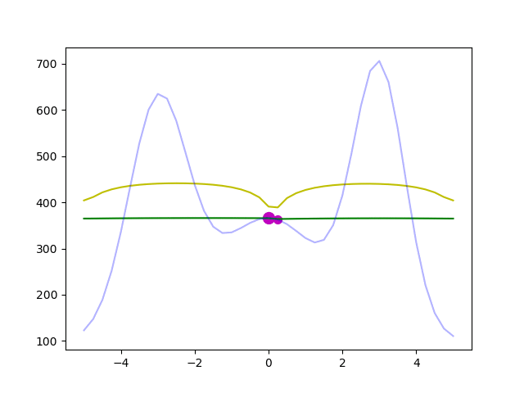
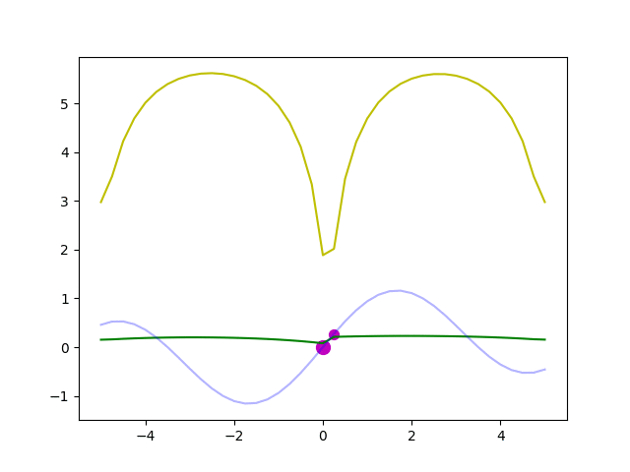
GMRF-UCB: Before Experiment…
How should hyperparamters of GMRF should be set?
GP Libraries often sample some points (known as “burnin”) and estimate its hyperparamters by optimizing the log-marginal-likelihood (or MCMC)
But this didn’t work well in GMRF☹
In our many experiments, we found that these worked well
Normalizing output (mean0var1 or min0max1)
Pairwise-sampling, then estimate and the other hyperparameters
Pairwise grid-based burn-in
Ground Truth
Predicted Mean
Predicted UCB
Notes:
Pairwise sampling means sampling adjacent points simultaneously as you can see in this GIF.
By Pairwise sampling , we can estimate the hyperparamters.
When the diminsion is one, GMRF could find the global optimal solution.

Slide 31
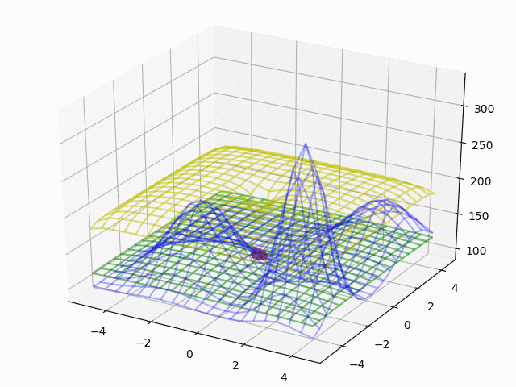
GMRF-UCB: Before Experiment…
How should hyperparamters of GMRF should be set?
GP Libraries often sample some points (known as “burnin”) and estimate its hyperparamters by optimizing the log-marginal-likelihood (or MCMC)
But this didn’t work well in GMRF☹
In our many experiments, we found that these worked well
Normalizing output (mean0var1 or min0max1)
Pairwise-sampling, then estimate and the other hyperparameters
Pairwise grid-based burn-in
Ground Truth
Predicted Mean
Predicted UCB
Notes:
When the diminsion is two, GMRF could also find the global optimal solution.

Slide 32
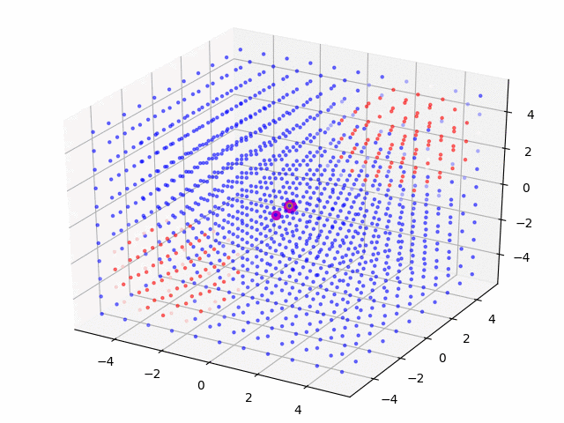
GMRF-UCB: Before Experiment…
How should hyperparamters of GMRF should be set?
GP Libraries often sample some points (known as “burnin”) and estimate its hyperparamters by optimizing the log-marginal-likelihood (or MCMC)
But this didn’t work well in GMRF☹
In our many experiments, we found that these worked well
Normalizing output (mean0var1 or min0max1)
Pairwise-sampling, then estimate and the other hyperparameters
Pairwise grid-based burn-in
High
Low
Notes:
When the diminsion is three, GMRF also could find the global optimal solution.
So pairwise-sampling is effective to estimate the hyperparamter of GMRF, but …

Slide 33
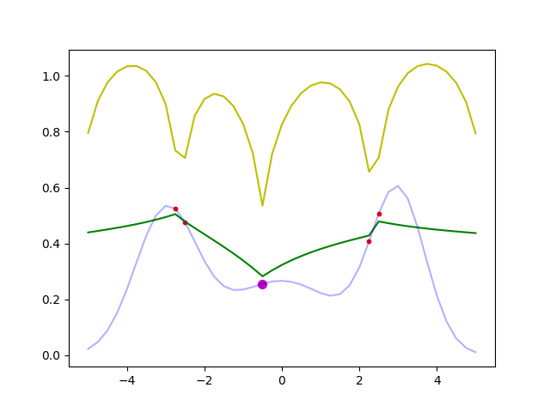
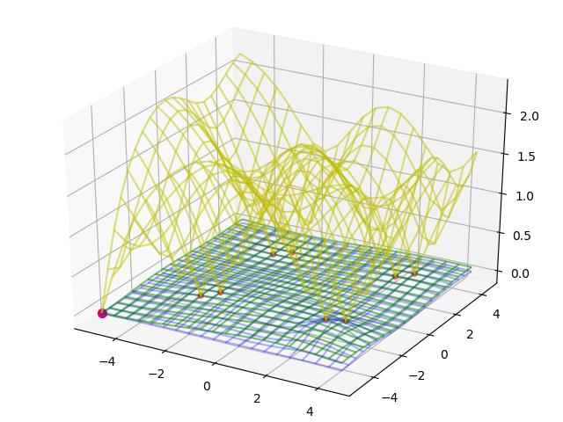
GMRF-UCB: Before Experiment…
How should hyperparamters of GMRF should be set?
GP Libraries often sample some points (known as “burnin”) and estimate its hyperparamters by optimizing the log-marginal-likelihood (or MCMC)
But this didn’t work well in GMRF☹
In our many experiments, we found that these worked well
Normalizing output (mean0var1 or min0max1)
Pairwise-sampling, then estimate and the other hyperparameters
Pairwise grid-based burn-in
Sampling only center 2*d points as burn-in
Ground Truth
Predicted Mean
Predicted UCB
Notes:
Continuing pairwise sampling is not so good because one point has a little poorer performance than the other.
We find it efficient to start just pairwise sampling center 2d points as burnin then quit pairwise sampling.

Slide 34
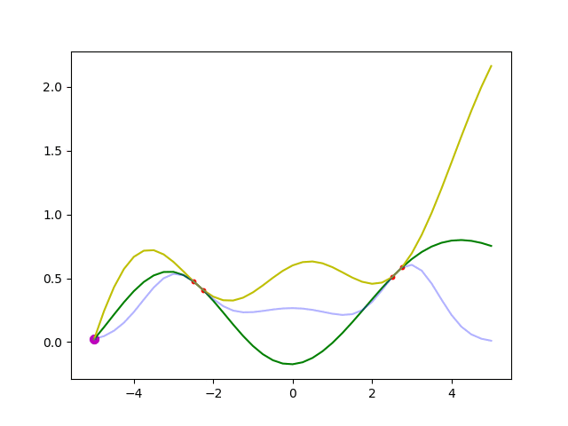
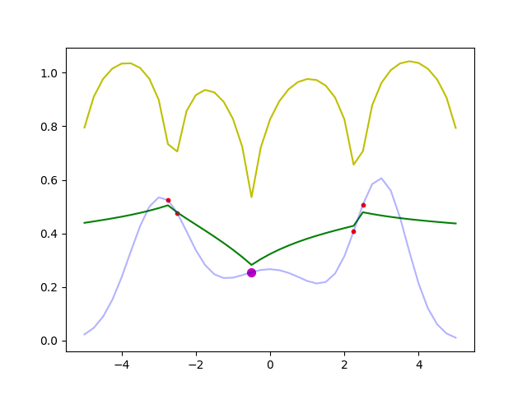
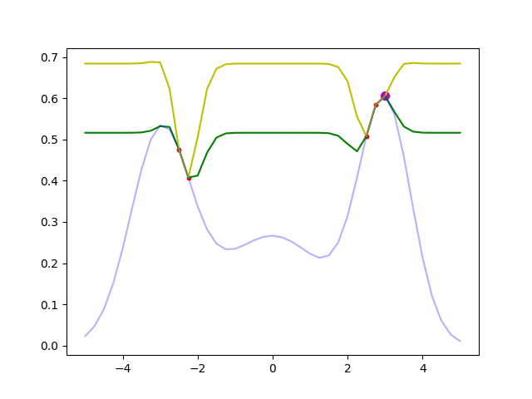
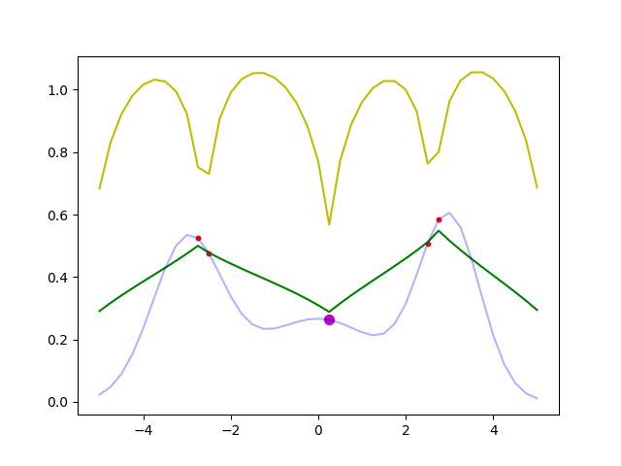
Result: Comparison between GP-UCB and GMRF-UCB
The performance of GP is affected by its Kernel hyperparameter
GP
GMRF
Fixed Kernel
Mean0-Var1 Normalization
Ground Truth
Predicted Mean
Predicted UCB
Unfixed Kernel
Min0-Max1 Normalization
Notes:
This is the result of GP-UCB and GMRF-UCB.
All could find the global optimal solution.
But If we unfix the kernel of GP, the predicted UCB sometimes becomes unstable.

Slide 35
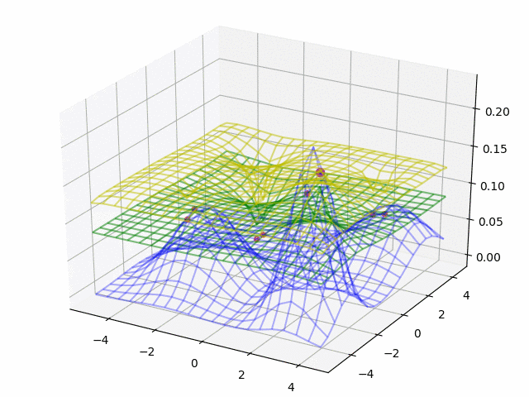
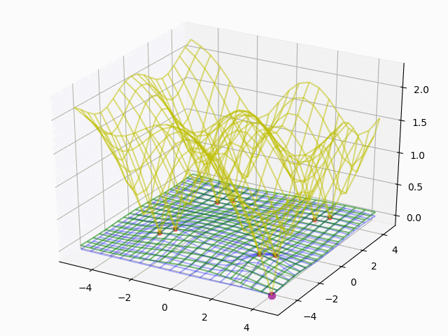
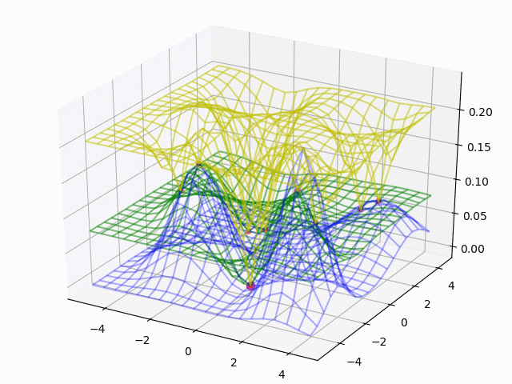
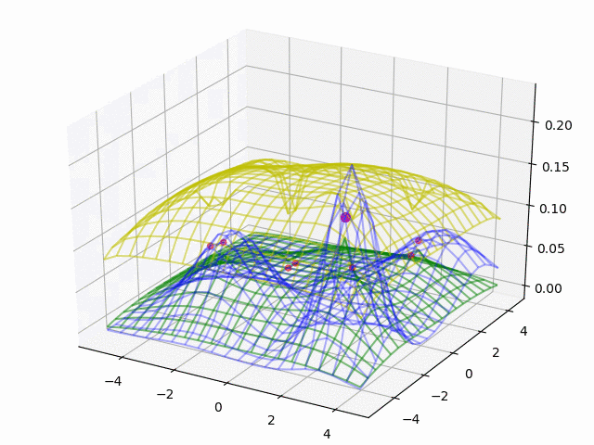
Result: Comparison between GP-UCB and GMRF-UCB
The performance of GP is affected by its Kernel hyperparameter
GP
GMRF
Fixed Kernel
Mean0-Var1 Normalization
Ground Truth
Predicted Mean
Predicted UCB
Unfixed Kernel
Min0-Max1 Normalization
Notes:
When the dimension is 2, GP seems to exploit much more than GMRF.
GMRF can constantly sample good points.

Slide 36
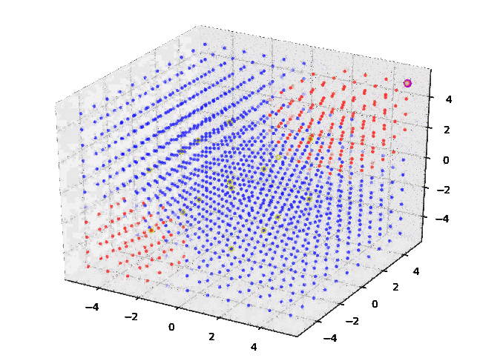
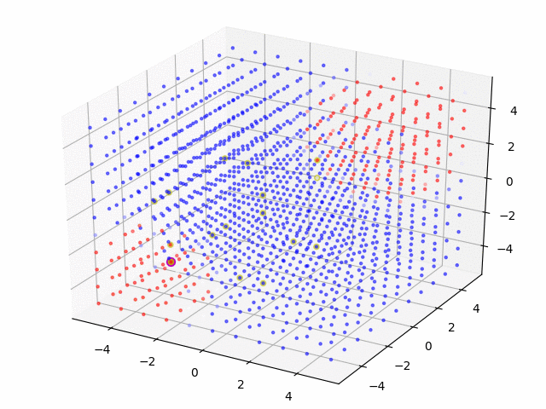
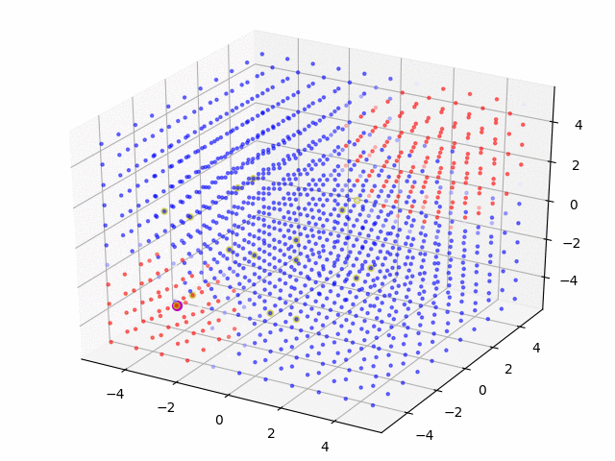


Result: Comparison between GP-UCB and GMRF-UCB
The performance of GP is affected by its Kernel hyperparameter
GP
GMRF
Fixed Kernel
Mean0-Var1 Normalization
High
Low
Unfixed Kernel
Min0-Max1 Normalization
Notes:
When the dimension is 3, GP seems to exploit too many times except when unfixed mattern kernel is used.
On the other hand, GMRF can constantly sample good points, nicely exploiting.

Slide 37
Acquisition Functions except UCB
Actually UCB is just one solution. The others are
Thompson Sampling (TS) :
Just sampling. Performance is good, but computation is heavy…
Probability Improvement (PI):
PI is said to be too greedy.
Expected Improvement (EI):
EI seems to be the most popular. (In most libraries, default setting is EI)
Notes:
So far we used UCB as acquisition function.
Actually, there are other acquisition functions.
TI, PI, EI.
EI seems…

Slide 38
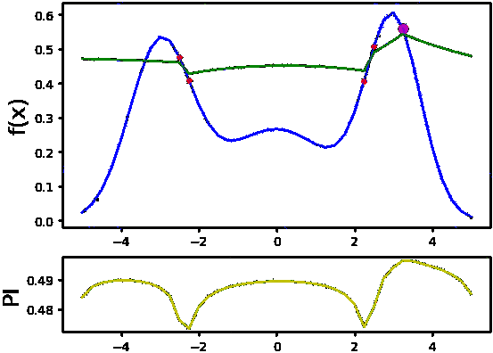
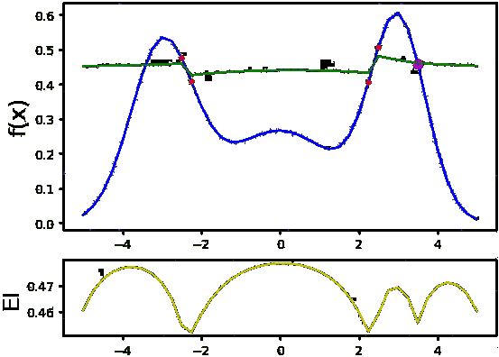
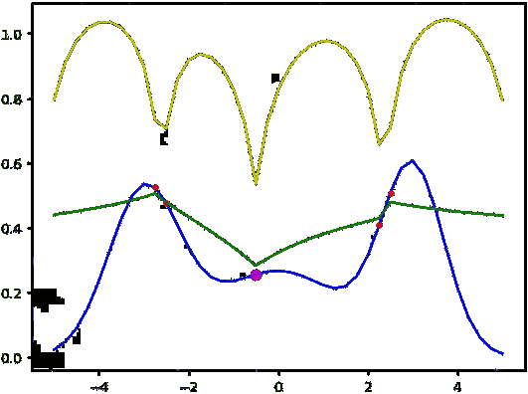
Result: Comparison of different acquisition functions (GMRF)
UCB
PI
EI
Ground Truth
Predicted Mean
Predicted Acq.
Notes:
PI is said to exploit too many times.
This fact could be confirmed in this experiment.
UCB and EI is similar and they are better than PI.

Slide 39
Idea of GMRF Application to improve CTR
Notes:
O.K. From now, Let me explain the Idea of GMRF Application to improve CTR.

Slide 40
How to apply GMRF for improving CTR
So far, we sampled just one(or a few) time(s) per point.
When we tune the hyper-parameter of some ML (e.g. Recommendation) engine for improving CTR, the number of samples per point are quite many.
In order to apply GMRF,
CTR data can be converted to real value using logit function.
 | Visit | Click
Point20 | 1000 | 123
Point21 | 1000 | 99
Point09 | 1000 | 876
... | ... | ...
 | Visit | Val
Point20 | 1000 | -1.964
Point21 | 1000 | -2.208
Point09 | 1000 | 6.906
... | ... | ...

Slide 41
Flow of GMRF application for improving CTR
 | Visit | Click
Point20 | 1000 | 123
Point21 | 1000 | 99
Point09 | 1000 | 876
... | ... | ...
 | μ | σ
Point01 | 0.021 | 3.5e-5
Point02 | 0.014 | 5.1e-5
Point03 | -0.013 | 8.7e-6
... | ... | ...
GMRF
CTR Experiment
 | Visit | Click
Point01 | 1500 | ?
Point02 | 3000 | ?
Point03 | 4000 | ?
... | ... | ...
Total Impressions
Generate probability
per point
MB Bandit
Notes:
This is the Flow of GMRF application for improving CTR.
Using GMRF, we can distribute total impression to each point EFFICIENTLY.

Slide 42
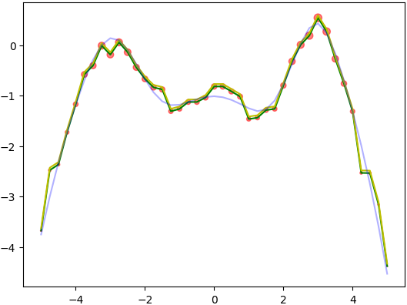
Result of GMRF application for improving CTR
The number of impressions
per one iteration is set 10000
Ground Truth
Predicted Mean
Predicted UCB
At first,
10000 impressions are distributed equally to each point
Then GMRF was applied.
After 1st iteration
Size of shows the distribution of clicks
Notes:
I conducted the simulation of this application.
The number of impressions per one iteration is set 10000.
At first, 10000 impressions are distributed equally to each point. Then GMRF was applied.
After 1 iteration, you can see that the higher performance the point has, the more impressions are ditributed!

Slide 43
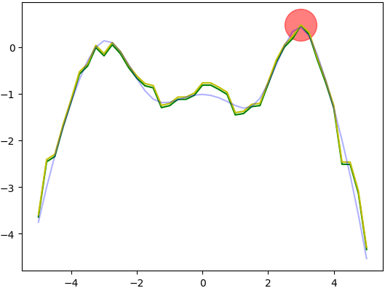
Result of GMRF application for improving CTR
The number of impressions
per one iteration is set 10000
Ground Truth
Predicted Mean
Predicted UCB
At first,
10000 impressions are distributed equally to each point
Then GMRF was applied.
After 1st iteration
Size of shows the distribution of clicks
Found the best point and
Converged!
After 2nd iteration
Notes:
After 2nd iteration, all the impressions are distributed to the best point and sucessfully converged!

Slide 44
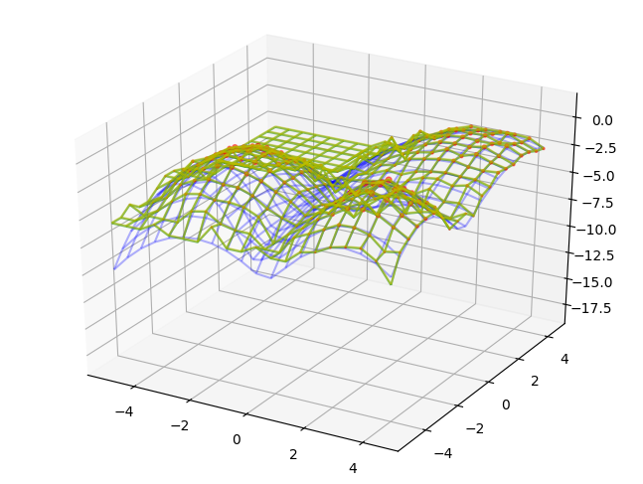
Result of GMRF application for improving CTR
The number of impressions
per one iteration is set 10000
After 1st iteration
Ground Truth
Predicted Mean
Predicted UCB
At first,
10000 impressions are distributed equally to each point
Then GMRF was applied.
Size of shows the distribution of clicks
Notes:
When the dimension is 2, the result was similar with that of 1 dimension.
After 1 iteration, you can see that the higher performance the point has, the more impressions are ditributed!

Slide 45
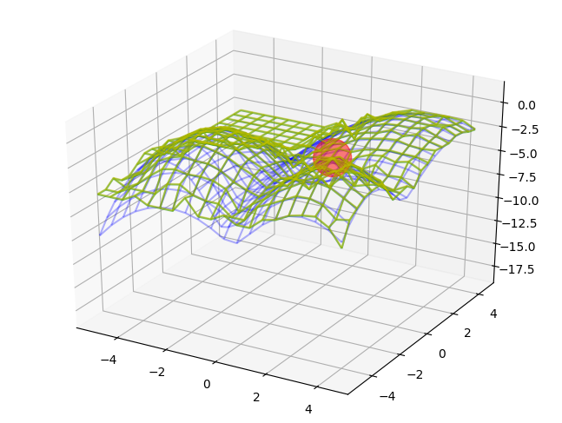
Result of GMRF application for improving CTR
The number of impressions
per one iteration is set 10000
After 1st iteration
Ground Truth
Predicted Mean
Predicted UCB
At first,
10000 impressions are distributed equally to each point
Then GMRF was applied.
Size of shows the distribution of clicks
After 2nd iteration
Found the best point and
Converged!
Notes:
After 2nd iteration, all the impressions are distributed to the best point and sucessfully converged!

Slide 46
Summary and Future Work
Summary
Propose to use GP and GMRF for hyperparamter optimization
Propose the way to apply GMRF for improving CTR
Future work
Find or fix(?) the way to optimize hyperparamter of GMRF (Pairwise sampling should be avoided)
Write a paper with new intern Mr. Zhao and my mentor Dr. Yang
Extend our model to dynamic version

Slide 47
Appendix

Slide 48
References
ベイズ的最適化(Bayesian Optimization)の入門とその応用
https://www.slideshare.net/issei_sato/bayesian-optimization

Slide 49
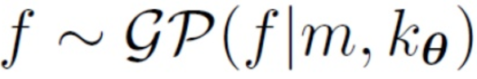
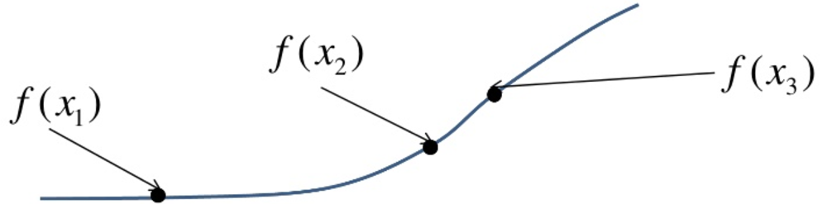
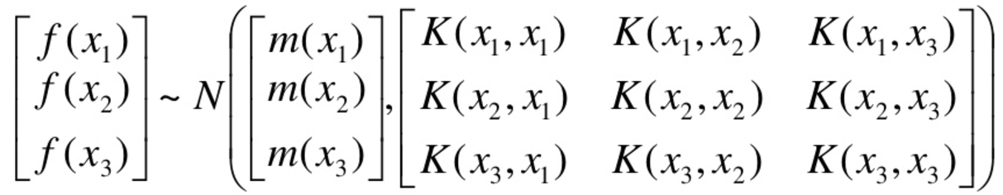
GP-UCB: What is GP?
Gaussian Process
Every point in some continuous input space is associated with a normally distributed random variable
“Kernel”
Distance between two points
e.g.) Gaussian Kernel
“Mean”

Slide 50
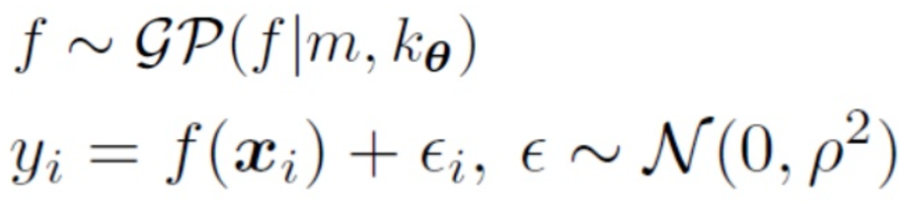
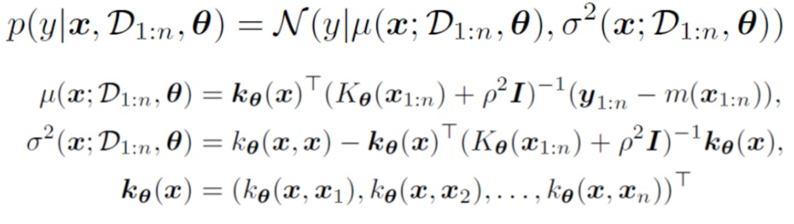
GP-UCB: How does GP predict?
Generation Process
Bayesian Predicted Distribution

Slide 51
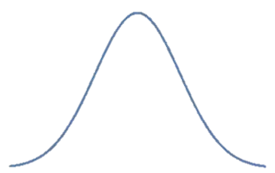
GP-UCB: What is UCB (Upper Confidence Bound) ?
Next Sampling point
Notes:
Add more info

Slide 52
GMRF-UCB: Introduction
Split the continuous space to discrete one
Considering that the adjacent point has relation with each other, Simply model this, introducing hidden nodes!
The joint probability can be calculated as follows;
: the connection strength between and
: the connection strength between and
Hidden node
Observed node

Slide 53
GMRF-UCB: How to model
Let’s make this model more sophisticated
The joint probability can be calculated as follows;
: the connection strength between and
: the connection strength between and
Hidden node
Observed node
Two Points of Modification
should have prior Gaussian distribution
The number of would be plural ( should be replaced to )
①
②
Removed
Index
to simplify
Real
Simple

Slide 54
GMRF-UCB: How to model
Let’s make this model more sophisticated
The joint probability can be calculated as follows;
: the connection strength between and
: the connection strength between and
Hidden node
Observed node
Combining these….
①
②
Removed
Index
to simplify
Real
Simple

Slide 55
GMRF-UCB: How to model
Final GMRF can be calculated as follows;

Slide 56
GMRF-UCB: How to model
Final GMRF can be calculated as follows;

Slide 57
GMRF-UCB: How to model
Final GMRF can be calculated as follows;
Why A’ is used instead of A?

Slide 58
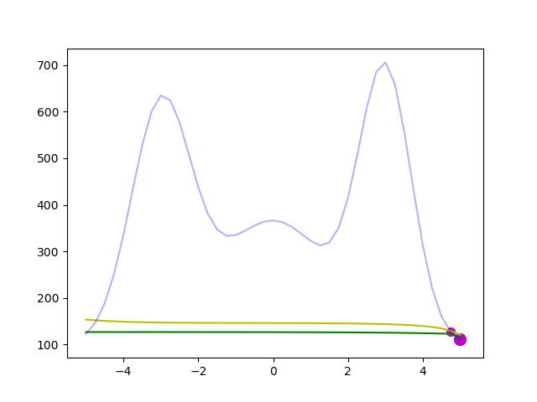
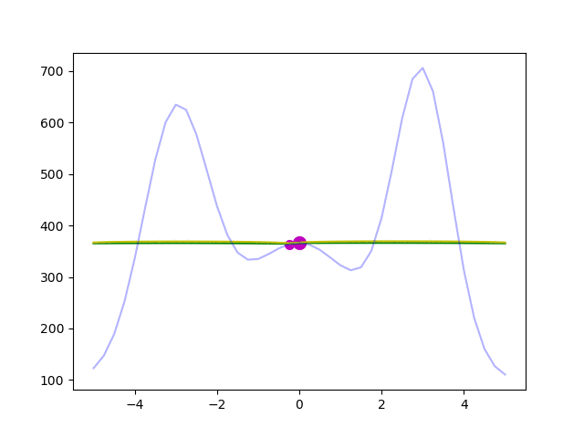
GMRF-UCB: How to model
Comparison between A and A’
Ground Truth
Predicted Mean
Predicted UCB
If A is used, edge points are easier to be selected than center points

Slide 59
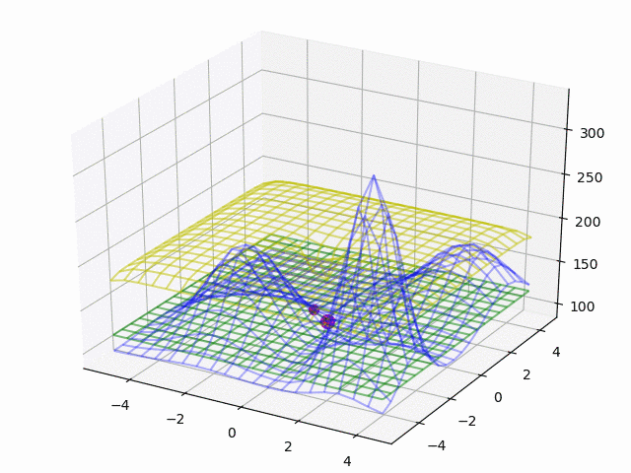
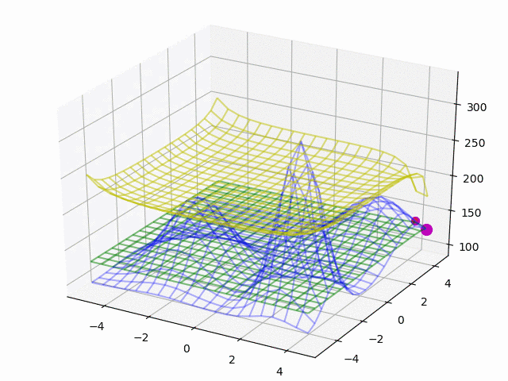
GMRF-UCB: How to model
Comparison between A and A’
Ground Truth
Predicted Mean
Predicted UCB
If A is used, edge points are easier to be selected than center points

Slide 60
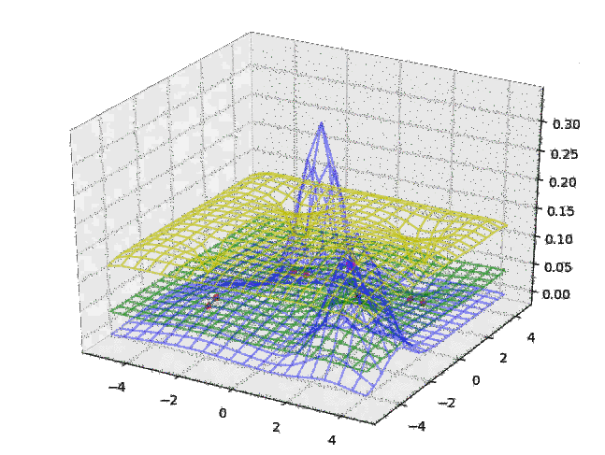
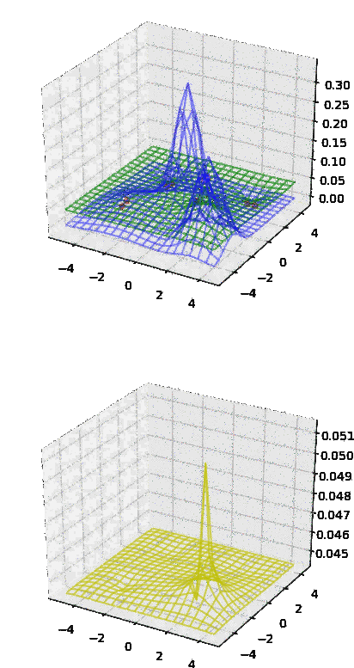
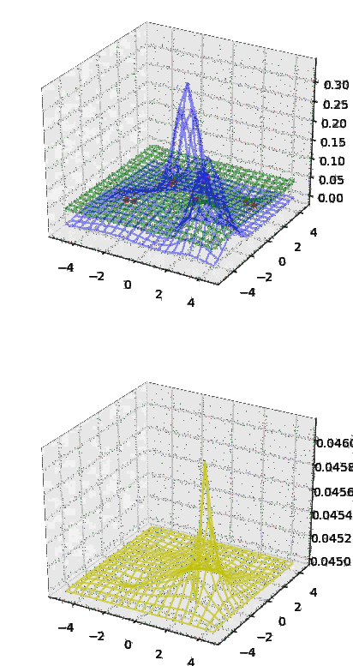
Poor Result: Comparison of different acquisition functions (GMRF)
UCB
PI
EI
Ground Truth
Predicted Mean
Predicted Acq.

